Slide 1
Artificial Intelligence
Knowledge Representation & Reasoning

Slide 2
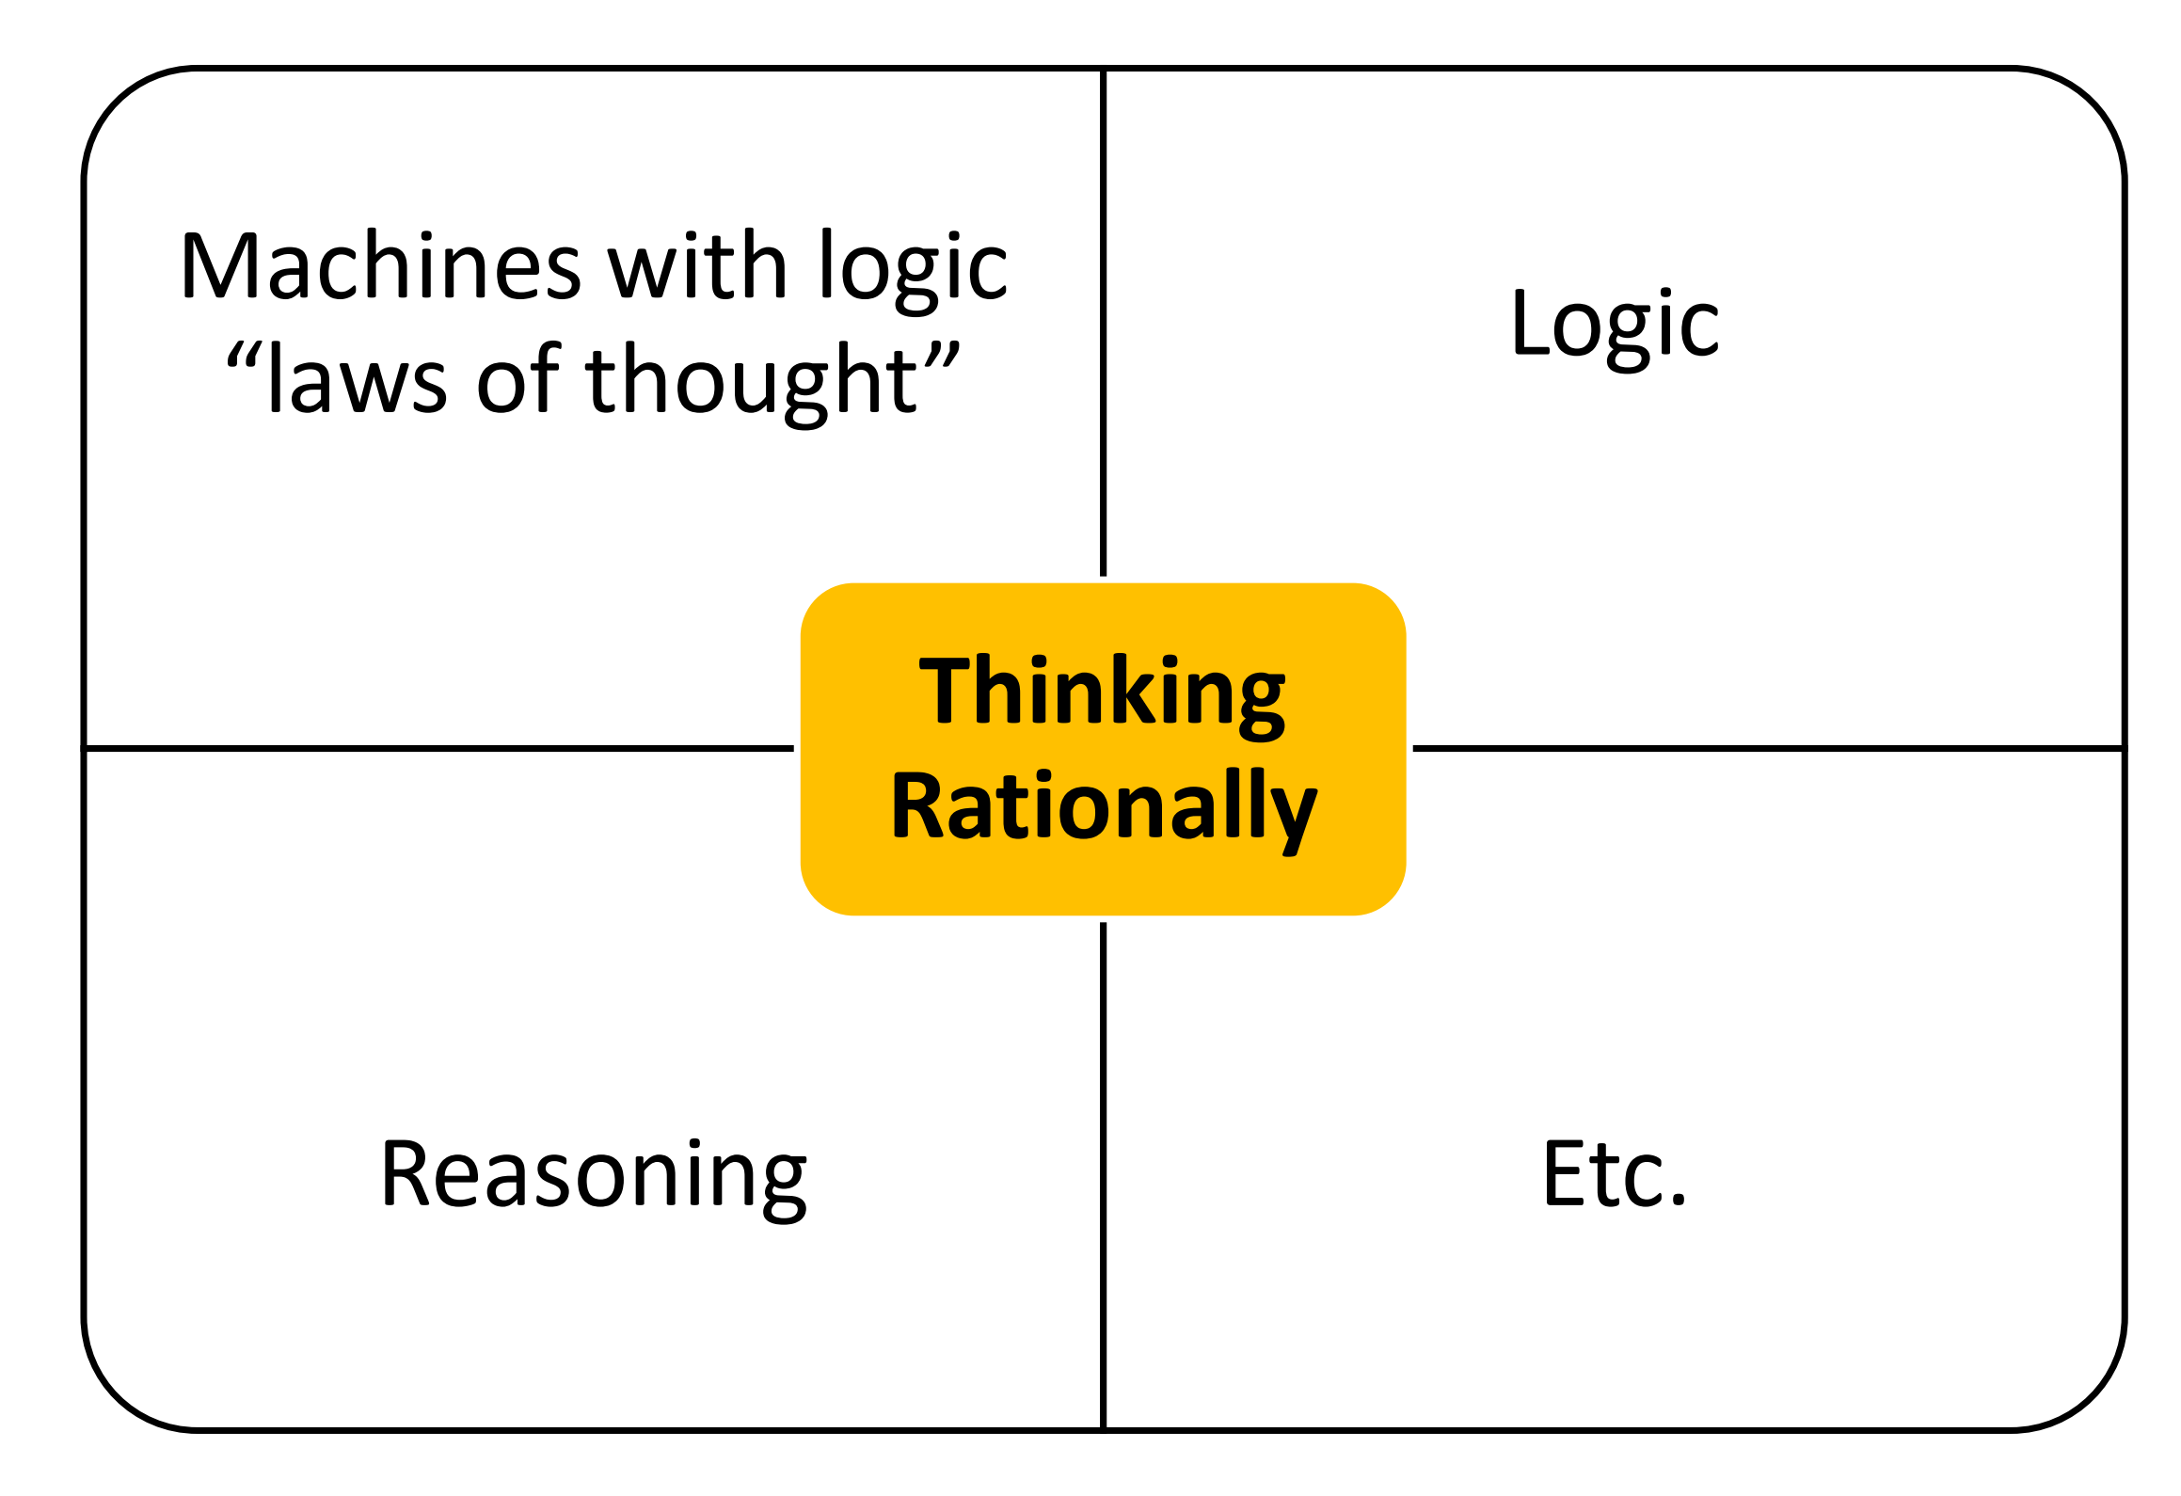
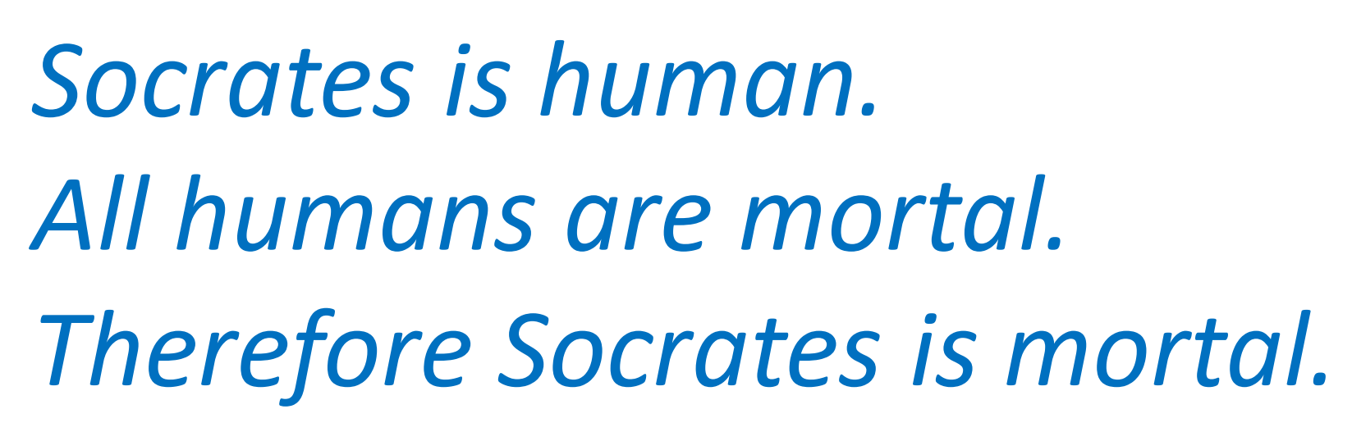
Thinking Rationally
The Laws of Thought are the basic principles that guide logical reasoning.
A syllogism is a form of logical reasoning developed by Aristotle, in which a conclusion is drawn from two premises.
It is one of the earliest formal systems of logic and the foundation of deductive reasoning.
Syllogistic arguments are usually represented in a three-line form:
These laws of thought govern the operation of the mind; their study initiated the field called logic.

Slide 3
What is Knowledge
Knowledge is a familiarity with someone or something, which can include facts, information, descriptions, or skills acquired through experience or education.
It can be explicit (as with the theoretical understanding of a subject).
    OR
implicit (as with practical skill or expertise).
In philosophy, the study of knowledge is called epistemology.
The philosopher Plato famously defined knowledge as “justified true belief”
The concept of justified true belief states that in order to know that a given proposition is true, one must not only believe the relevant true proposition, but also have justification for doing so.
Statement: It is true that “Water boils at 100°C.”
Belief: I believe that “Water boils at 100°C.”
Justification: I have measured water boiling at 100°C many times, or I trust scientific evidence.

Slide 4
Types of Knowledge
Declarative knowledge:
  knowing what something is.
  Declarative knowledge refers to the statements of facts about the world.
  e.g. it is sunny today, cherries are red, earth revolves around the sun. etc.
Procedural knowledge:
  knowing how to perform a task.
  Procedural knowledge is compiled or processed form of information.
  Procedural knowledge is related to the performance of some task.
  It relies on rules to provide a set of directions of how to perform a certain task,
  e.g., how to drive a car, how to cook a recipe etc.

Slide 5
Knowledge Representation Techniques
Knowledge Representation is about how to store knowledge in a form that a computer can use to reason, make decisions, or solve problems intelligently.
There are several classic and modern ways to represent knowledge in AI.
  Semantic Networks
  Frames
  Production Rules
  Logical Representation
    Propositional Logic
    Predicate Logic

Slide 6
Semantic Networks
A Semantic Network (or Semantic Net) is a graph-based representation of knowledge that shows how concepts (things, ideas, or objects) are related to each other through links or relationships.
It represents meaning (semantics) using a network of nodes (concepts) and edges (relationships).
Component | Meaning | Example
Nodes | Concepts or objects | “Bird”, “Animal”, “Penguin”, “Wings”
Edges/Links | Relationships between concepts | “is-a”, “has”, “can”
Relationship Type | Example
IS-A (Inheritance) | “Penguin is a Bird”
PART-OF (Composition) | “Engine is part of Car”
HAS (Attribute) | “Bird has Wings”
CAN (Ability) | “Bird can Fly”
INSTANCE-OF | “Tweety is an instance of Bird”

Slide 7
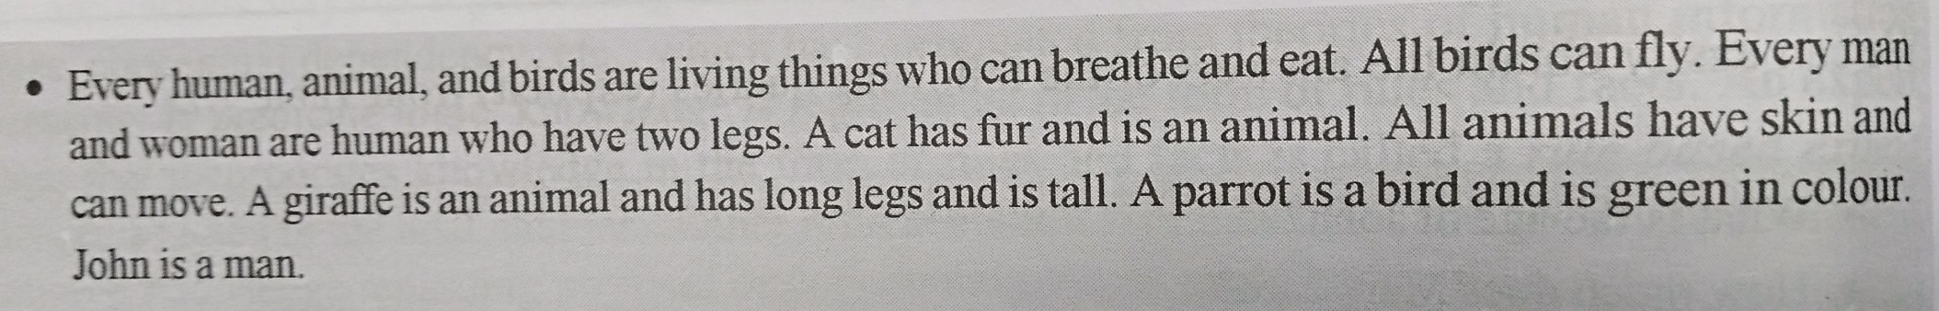
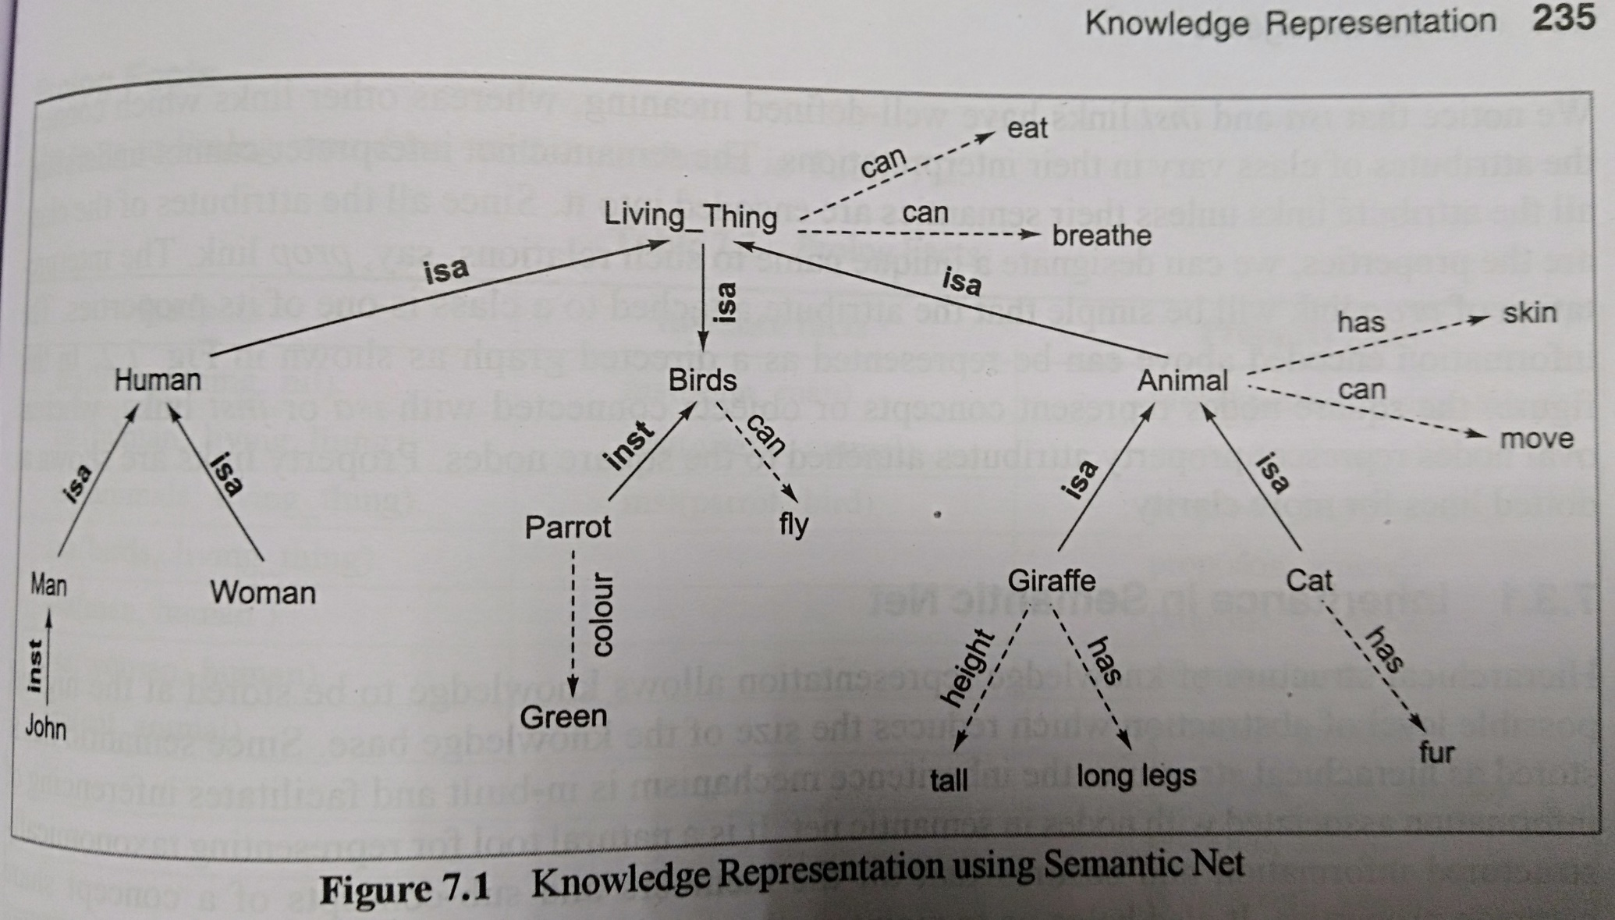

Slide 8
Production Rules
A production rules system is a rule-based knowledge representation system that expresses knowledge using IF–THEN statements.
It is primarily used to represent procedural knowledge, specifying what actions to take under certain conditions.
Components of a Production Rule
  Antecedent (Premise): The IF part of the rule, describing the condition(s).
  Consequent (Conclusion): The THEN part of the rule, describing the action or outcome.
For Example,
  IF it is raining THEN I will not go to school
  Premise (IF): It is raining
  Conclusion (THEN): I will not go to school
In a production rules system, rules fire when their premises match the facts, producing new facts or actions.

Slide 9
Facts
Facts are the basic building blocks of knowledge, representing atomic units of declarative knowledge.
Each fact can be expressed as a proposition, which is a statement that has an associated truth value, either true or false.
In AI, we represent knowledge using propositions and their truth values.
For Example,
  Proposition A: “It is raining.”
  Proposition B: “I have an umbrella.”
  Proposition C: “I will go to school.”
Here, each proposition corresponds to a fact, and the AI system can reason about these facts based on their truth values.

Slide 10
Logic
Logic is a tool for deriving reasonable conclusions from a given set of data. It provides a formal system for describing states of affairs, consisting of three main components: syntax, semantics, and proof theory.
Syntax defines the rules for constructing valid sentences, known as well-formed formulas (wffs). For example,
  “x + y = 4” is a well-formed sentence, whereas
  “x4y+ =” is not.
Semantics assigns meaning to sentences and specifies their truth in relation to possible worlds. For instance, in arithmetic:
  The sentence “x + y = 4” is true in a world where x = 2 and y = 2,
  but false in a world where x = 1 and y = 1.
Proof theory provides a set of rules for deducing the logical consequences of a set of sentences. It allows us to formally derive new truths from known statements.
Together, these components make logic a rigorous framework for reasoning, ensuring that conclusions are both well-formed and valid.

Slide 11
Types of Logic
Propositional Logic
  Deals with simple statements (propositions) that are either true or false.
  Each statement is treated as a single, indivisible unit; the logic only manipulates truth values using connectives like AND, OR, NOT, IMPLIES.
  Example:
    “It is raining AND it is cold” → True or False.
Predicate Logic
  Extends propositional logic by introducing objects, variables, properties, and relations.
  Allows quantifiers like ∀ (for all) and ∃ (there exists) to express general statements about multiple objects.
  Example:
    “All humans are mortal. Socrates is human. Therefore, Socrates is mortal.”
    Here, “human,” “mortal,” and “Socrates” are elements inside the proposition, not just a single true/false statement.

Slide 12
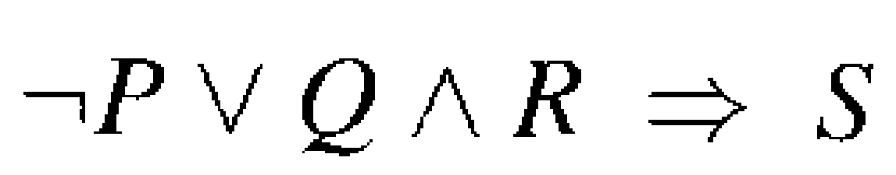
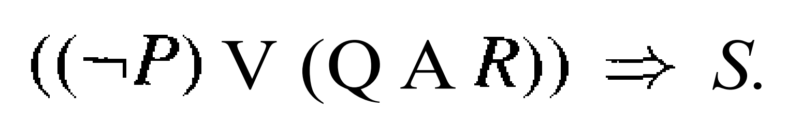
Propositional logic - Syntax
Symbols (alphabet):
  Constants: True (T), False (F)
  Propositional symbols: for example, P, Q, R, etc.
  Connective Symbols:
  ¬ ,∧ ,∨ , ⇒ , ⇔
The order of precedence in propositional logic is (from highest to lowest): ¬ ,∧ ,∨ , ⇒ , ⇔ .
Hence, the sentence
is equivalent to the sentence

Slide 13
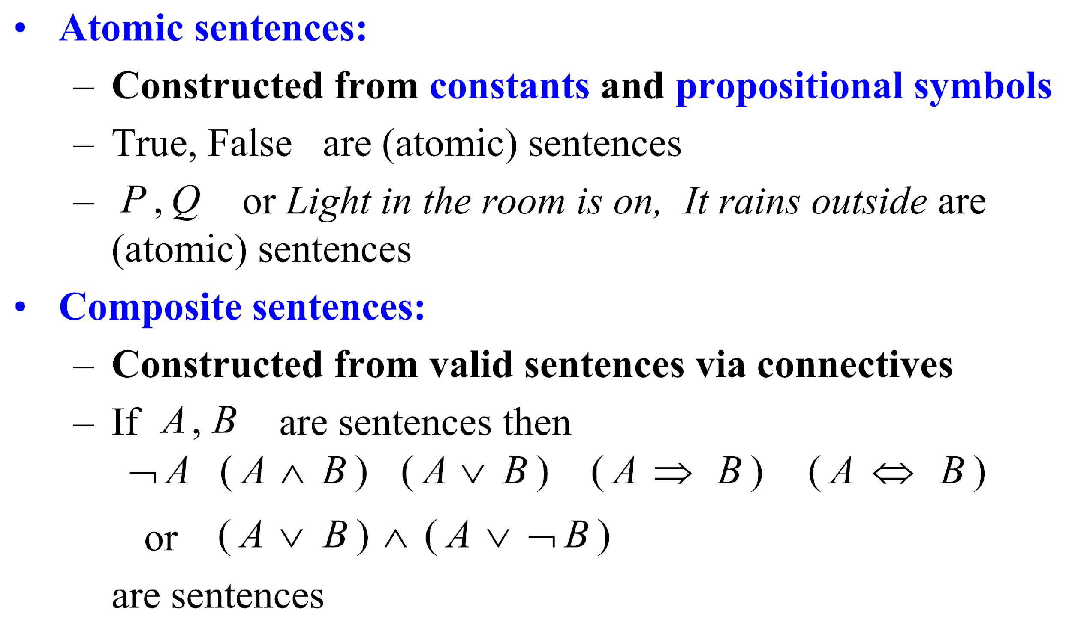
Propositional logic - Syntax

Slide 14
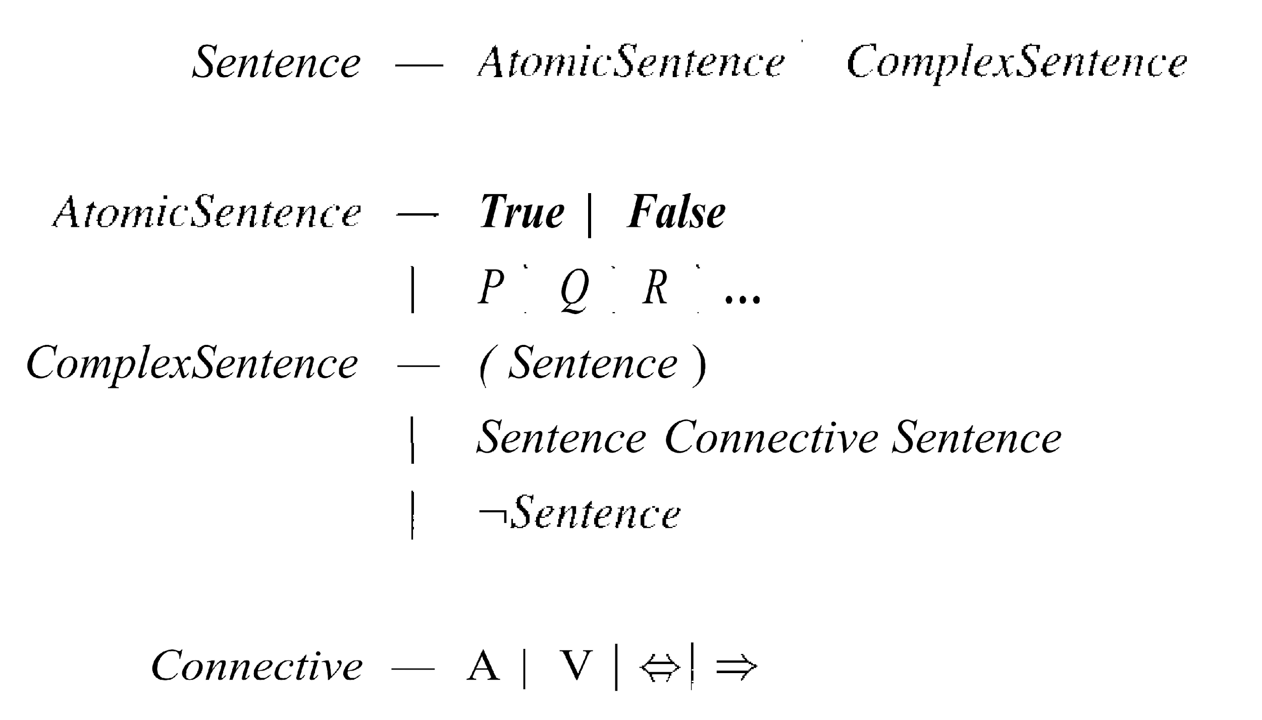
Propositional logic - Syntax

Slide 15
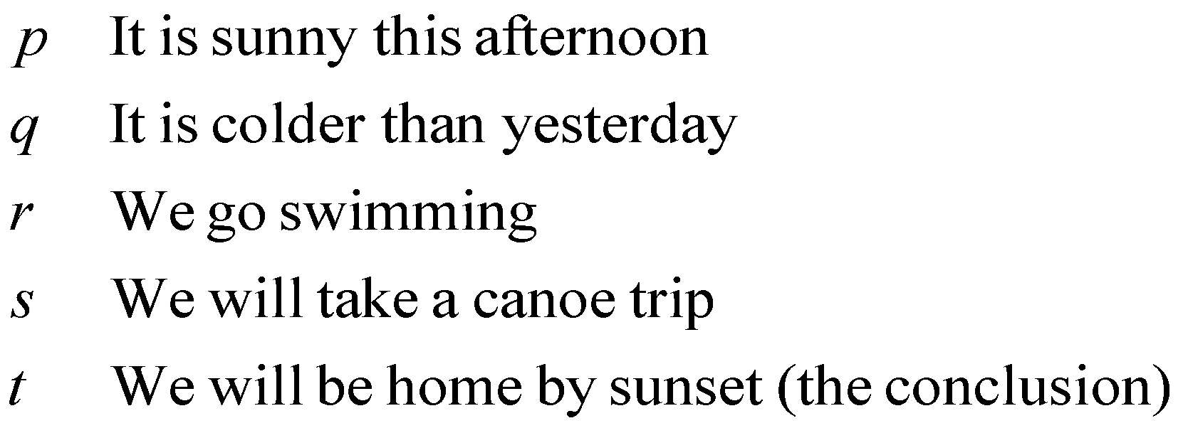
Proposition Translation
It is not sunny this afternoon and it is colder than yesterday.
If we go swimming it is sunny.
If we do not go swimming then we will take a canoe trip.
If we take a canoe trip then we will be home by sunset.
We will be home by sunset

Slide 16
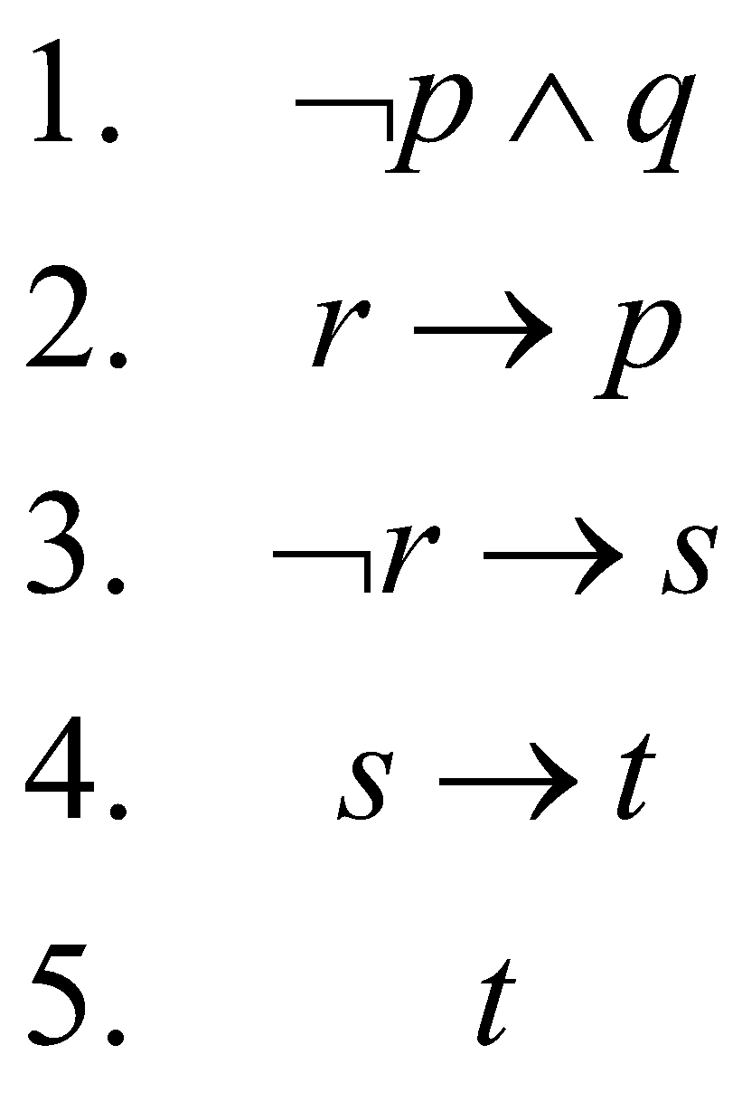
Proposition Translation
It is not sunny this afternoon and it is colder than yesterday.
If we go swimming it is sunny.
If we do not go swimming then we will take a canoe trip.
If we take a canoe trip then we will be home by sunset.
We will be home by sunset

Slide 17
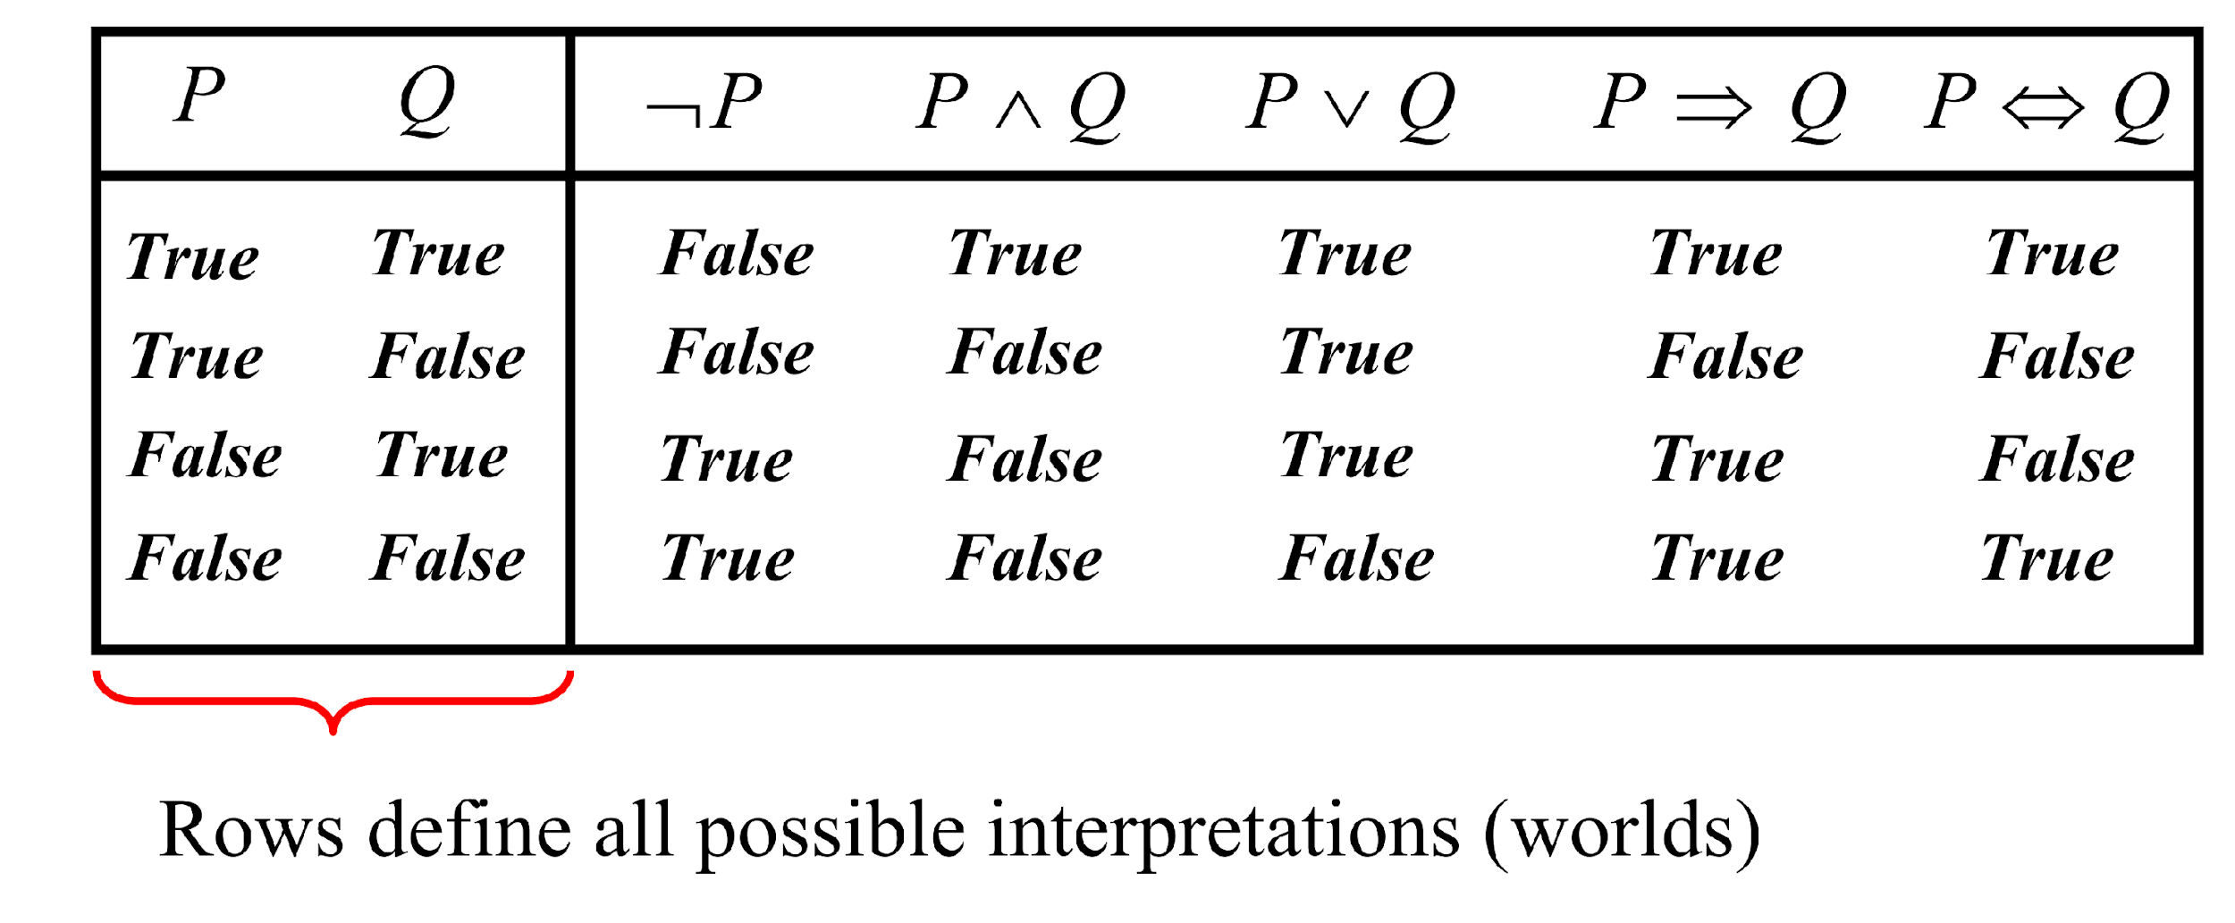
Propositional Logic – Semantics
Composite Sentences

Slide 18
Reasoning
Reasoning is the process of using knowledge to draw conclusions, make decisions, or solve problems. There are two main types of reasoning.
Deductive Reasoning
  Drawing a specific conclusion from general rules or facts.
  Example:
    Rule: All humans are mortal.
    Fact: Socrates is a human.
    Conclusion: Socrates is mortal.
Use in AI: Logic-based systems, rule-based expert systems.
Inductive Reasoning
  Drawing a general conclusion from specific observations.
  Example:
    Observation: Every swan I’ve seen is white.
    Conclusion: All swans are probably white.
  Use in AI: Machine learning, pattern recognition.

Slide 19
Inference
Inference is a specific operation within reasoning.
Every reasoning process involves one or more inferences to move from known facts and rules to new conclusions.
Inference is a way of syntactically generating new wffs from a set of wffs.
Entailment using truth tables is too expensive for most KBs (i.e. 2^{n} entries in the table).
Instead of truth tables, AI uses symbolic inference or theorem proving methods (like Modus Ponens, Resolution, or Forward/Backward chaining) to derive conclusions without enumerating all truth assignments.
The component of the system that performs inference is called an inference engine.

Slide 20
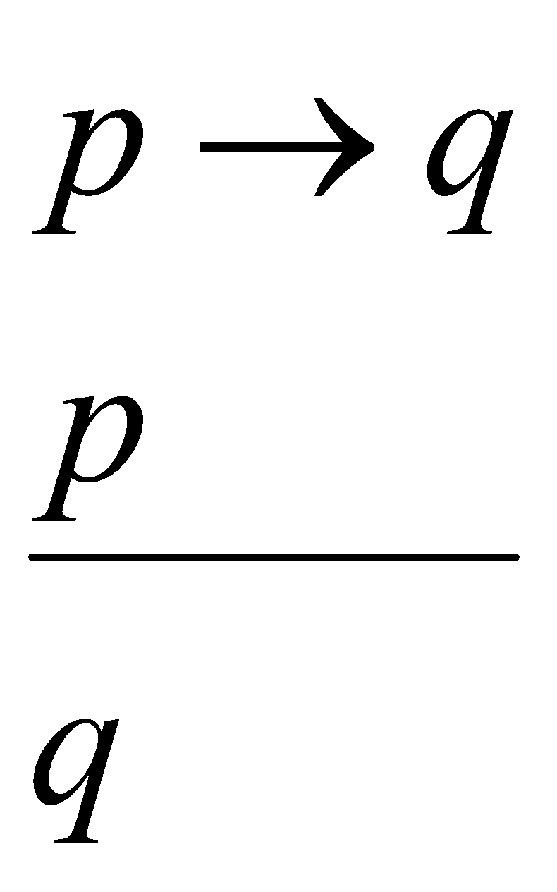
Rules of Inference
“Modus Ponens", “p implies q" and “p" you can conclude “q".
If you know that p implies q is true, and you know p to be true, you can automatically say that q is true
p
q
p ∧q
p ∨ q
p ⇒ q
p ⇔ q
T
T
T
T
T
T
T
F
F
T
F
F
Modus
Ponens
F
T
F
T
T
F
F
F
F
F
T
T

Slide 21
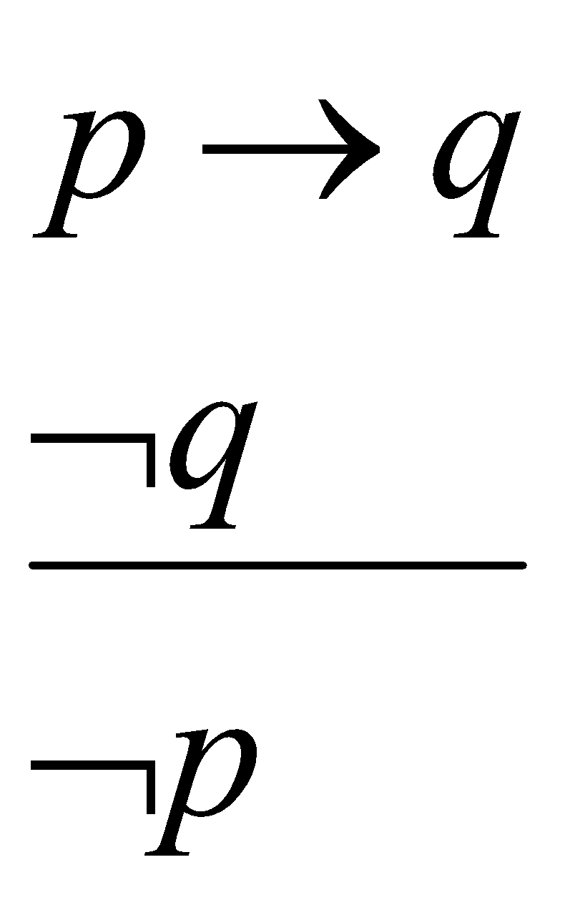
Rules of Inference
Modus Tollens: “p implies q" and "not q" you can conclude "not p".
If p implies q is true and q is known to be not true, then p could not have been true.
p
q
p ∧q
p ∨ q
p ⇒ q
p ⇔ q
T
T
T
T
T
T
T
F
F
T
F
F
Modus Tollens
F
T
F
T
T
F
F
F
F
F
T
T

Slide 22
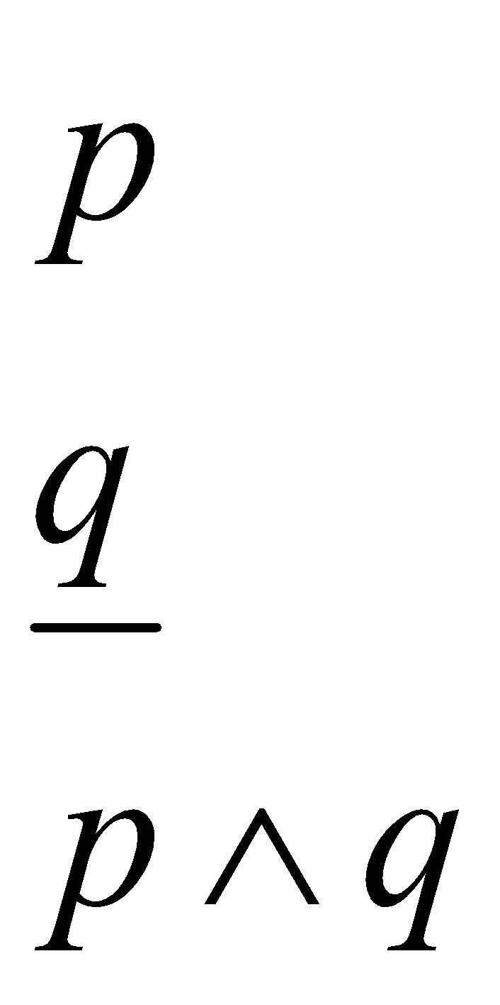
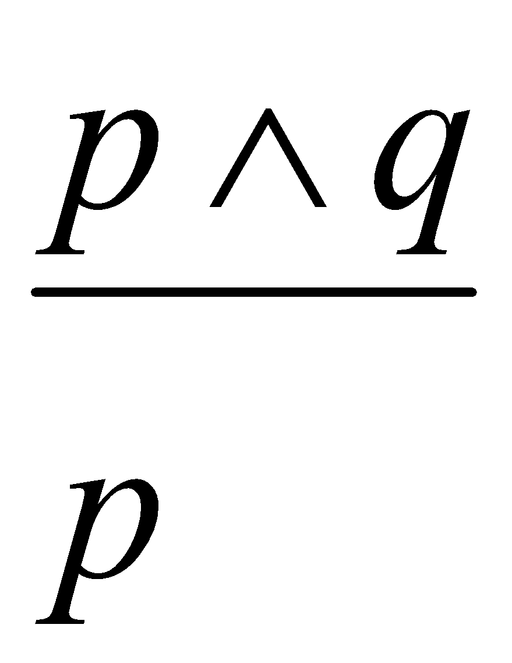
Rules of Inference
And-introduction say that if “p” is true and “q” is true you can conclude “p and q is also true".
Conversely, and-elimination says that if “p and q“ is true you can conclude “p” to be true.
And-
Introduction
And-
elimination

Slide 23
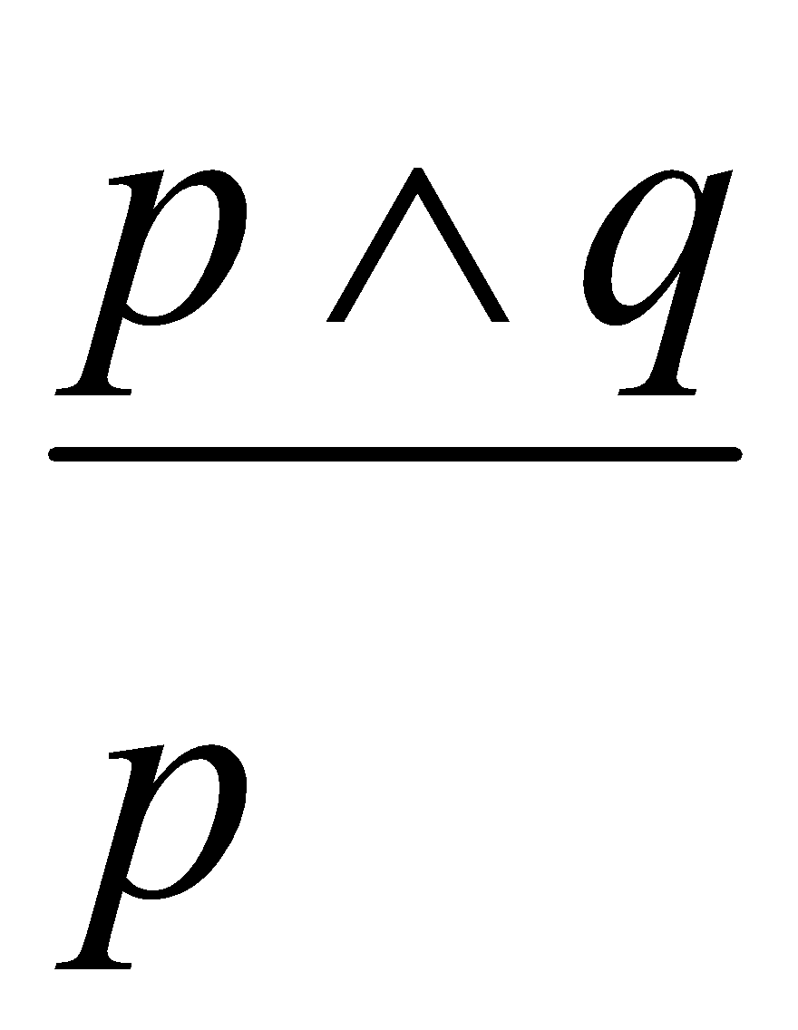
Rules of Inference
Modus
Ponens
Modus Tolens
And-
Introduction
And-
elimination

Slide 24
Rules of Inference
Rule | Description
Modus Ponens | P → Q, P → Infer: Q
Modus Tollens | P → Q, ¬Q → Infer: ¬P
Hypothetical Syllogism | P → Q, Q → R → Infer: P → R
Disjunctive Syllogism | P ∨ Q, ¬P → Infer: Q
Conjunction | P, Q → Infer: P ∧ Q
Simplification | P ∧ Q → Infer: P
Addition | P → Infer: P ∨ Q

Slide 25
Rules of Inference
Rule | Description | Example
Modus Ponens (→ Elimination) | If “P → Q” is true and P is true, then Q must be true. | P: “It rains” P → Q: “If it rains, the ground gets wet” Infer: “The ground gets wet”
Modus Tollens | If “P → Q” is true and Q is false, then P is false. | P → Q: “If it rains, the ground gets wet” ¬Q: “The ground is not wet” Infer: ¬P: “It did not rain”
Hypothetical Syllogism | If P → Q and Q → R, then P → R. | “If it rains, the ground gets wet” and “If the ground gets wet, the grass grows” → “If it rains, the grass grows”
Disjunctive Syllogism | From “P ∨ Q” and ¬P, infer Q. | “It is raining or it is snowing” and “It is not raining” → “It is snowing”
Conjunction | If P and Q are both true, infer P ∧ Q. | P: “It rains”, Q: “It is cold” → “It rains AND it is cold”
Simplification | From P ∧ Q, infer P (or infer Q). | “It rains AND it is cold” → “It rains”
Addition | From P, infer P ∨ Q. | “It rains” → “It rains OR it is sunny”

Slide 26
Inference Example
Prove S
Step | Formula | Derivation
1 | P ∧ Q | Given
2 | P→R | Given
3 | (Q ∧ R) →S | Given

Slide 27
Inference Example
Prove S
Step | Formula | Derivation
1 | P ∧ Q | Given
2 | P→R | Given
3 | (Q ∧ R) →S | Given
4 | P | 1 And-elimination

Slide 28
Inference Example
Prove S
Step | Formula | Derivation
1 | P ∧ Q | Given
2 | P→R | Given
3 | (Q ∧ R) →S | Given
4 | P | 1 And-elimination
5 | R | 4, 2 Modus Ponens

Slide 29
Inference Example
Prove S
Step | Formula | Derivation
1 | P ∧ Q | Given
2 | P→R | Given
3 | (Q ∧ R) →S | Given
4 | P | 1 And-elimination
5 | R | 4, 2 Modus Ponens
6 | Q | 1 And-elimination

Slide 30
Inference Example
Prove S
Step | Formula | Derivation
1 | P ∧ Q | Given
2 | P→R | Given
3 | (Q ∧ R) →S | Given
4 | P | 1 And-elimination
5 | R | 4, 2 Modus Ponens
6 | Q | 1 And-elimination
7 | Q ∧R | 5, 6 And-introduction

Slide 31
Inference Example
Prove S
Step | Formula | Derivation
1 | P ∧ Q | Given
2 | P→R | Given
3 | (Q ∧ R) →S | Given
4 | P | 1 And-elimination
5 | R | 4, 2 Modus Ponens
6 | Q | 1 And-elimination
7 | Q ∧R | 5, 6 And-introduction
8 | S | 7, 3 Modus Ponens

Slide 32
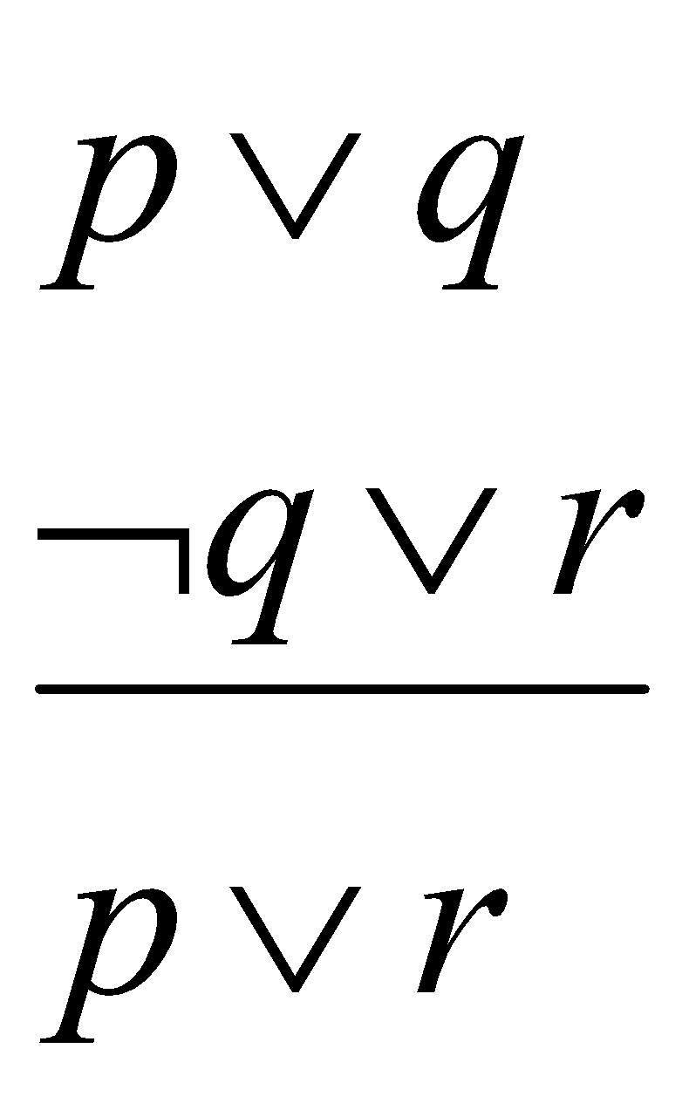
Resolution
The deduction mechanism we discussed may be used in practical systems but is not feasible.
It uses a lot of inference rules, which introduces a large branch factor in the search for a proof.
An alternative is Resolution, a strategy used to determine the truth of an assertion using only a single rule.
Resolution is the central inference rule used in automated theorem proving. It is used when you want to perform inference by proof by contradiction.
Only one Resolution rule:

Slide 33

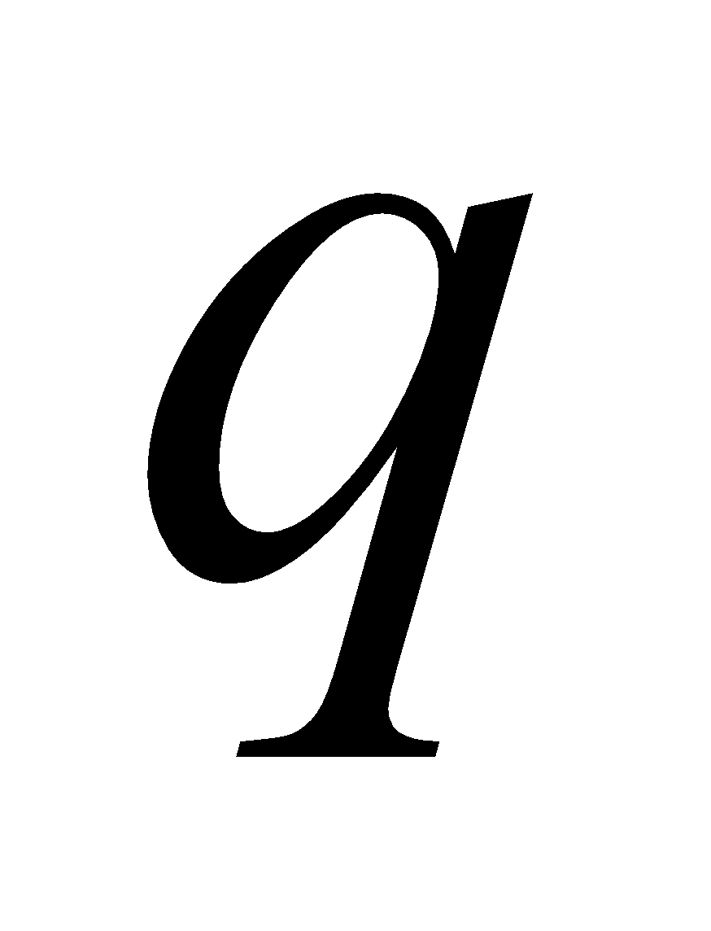

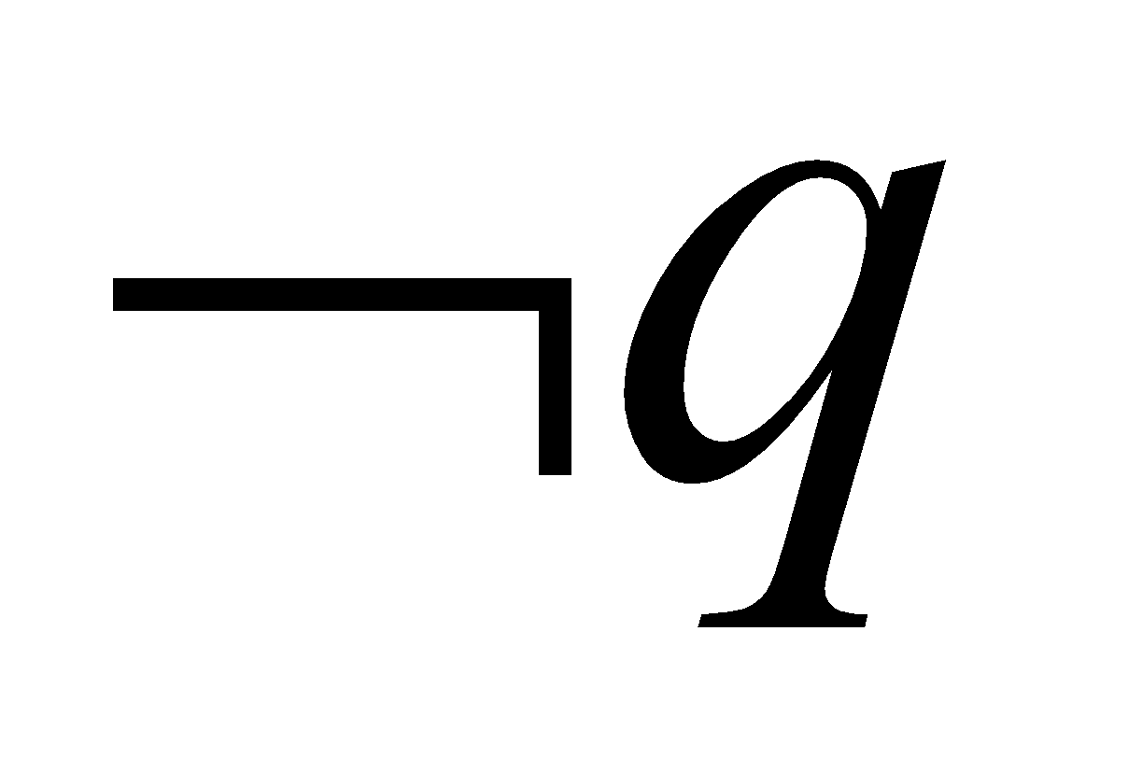
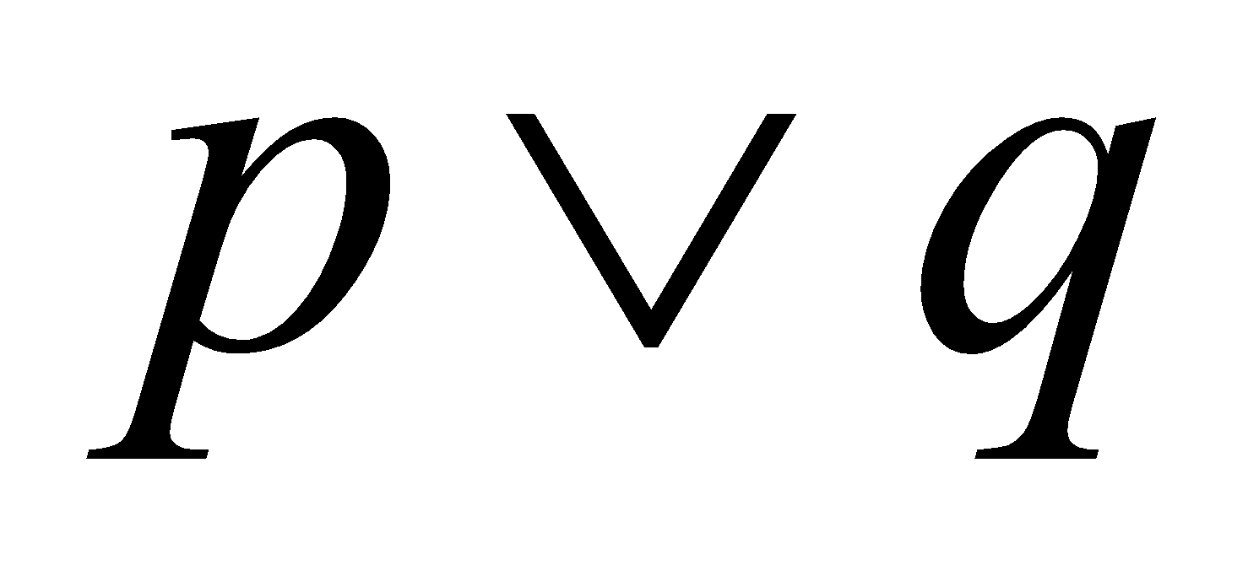
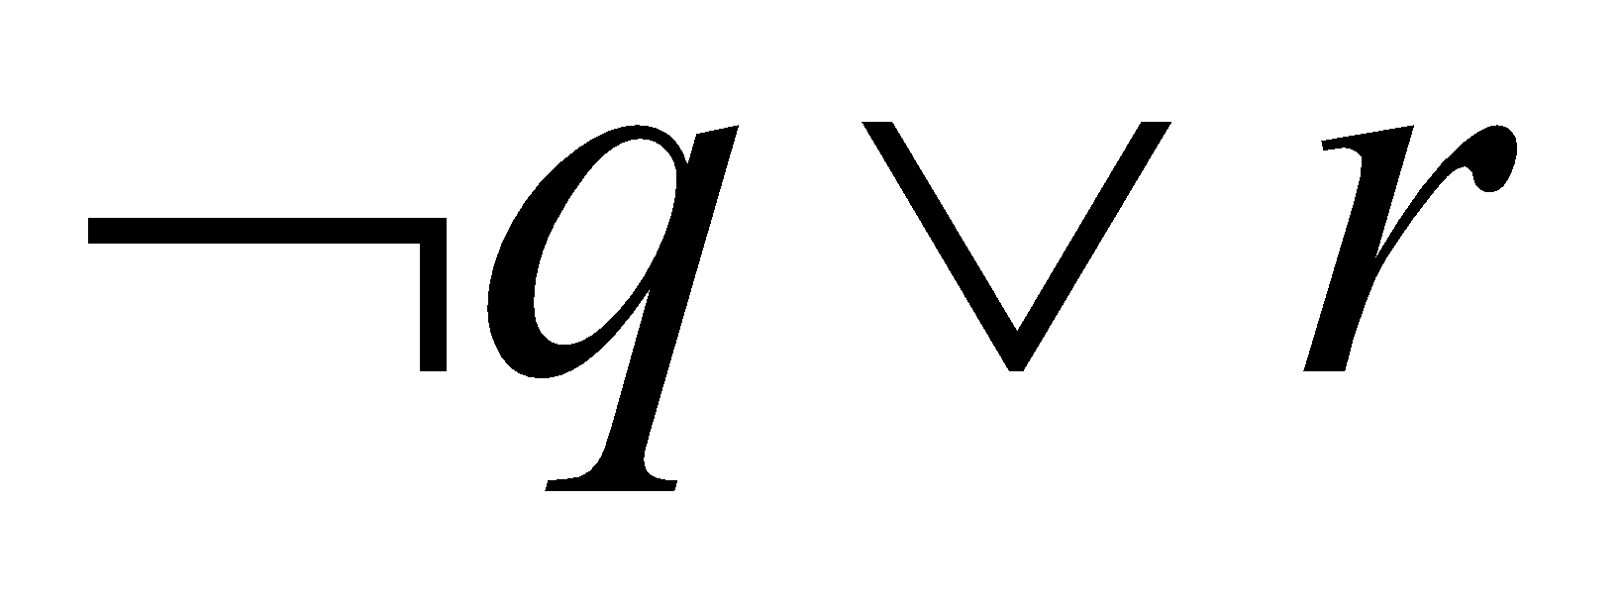
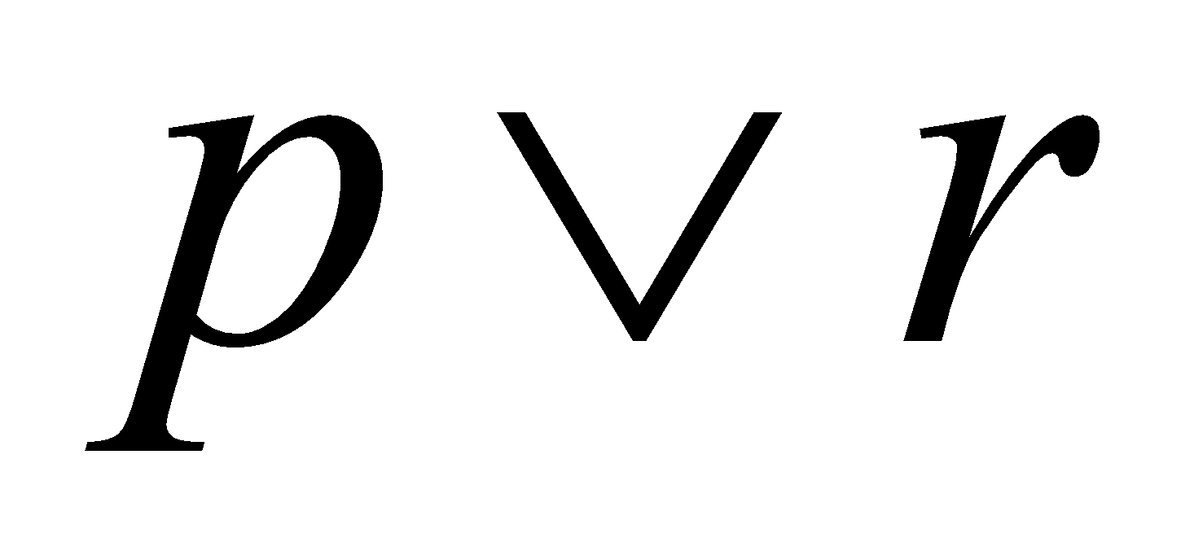
Resolution Rule
F | F | F | T | F | T | F
F | F | T | T | F | T | T
F | T | F | F | T | F | F
F | T | T | F | T | T | T
T | F | F | T | T | T | T
T | F | T | T | T | T | T
T | T | F | F | T | F | T
T | T | T | F | T | T | T

Slide 34
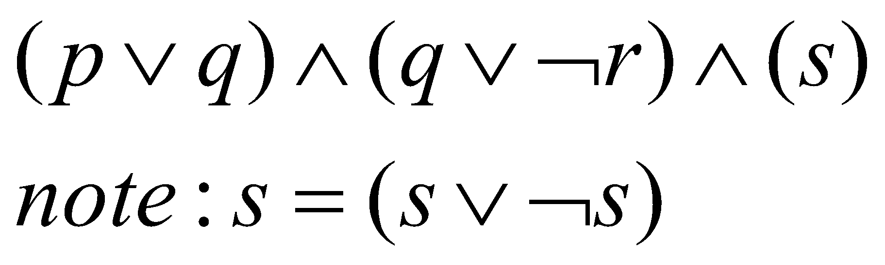
Conjunctive Normal Form
ANDs of Ors
Resolution requires all sentences to be converted into a special form called Conjunctive Normal Form (CNF).
CNF is a standardized way of writing logical expressions so they can be used easily by automated reasoning methods such as resolution.
A sentence written in CNF looks like
Outermost structure is made up of conjunctions. Inner units called clauses are made up of disjunctions.

Slide 35
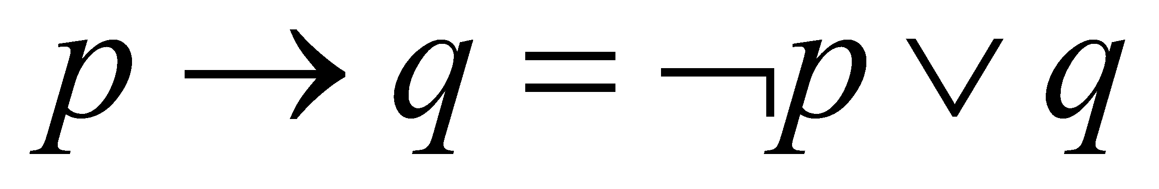
Convert to CNF
Eliminate ⇔ (implications)
  (A ∨ B) ⇔ (C ⇒ D) =
  ((A ∨ B) ⇒ (C ⇒ D)) ∧ ((C ⇒ D) ⇒ (A ∨ B))
  Eliminate arrows (implications)

Slide 36
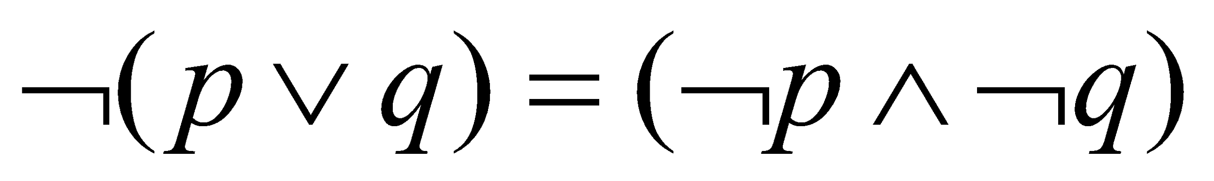
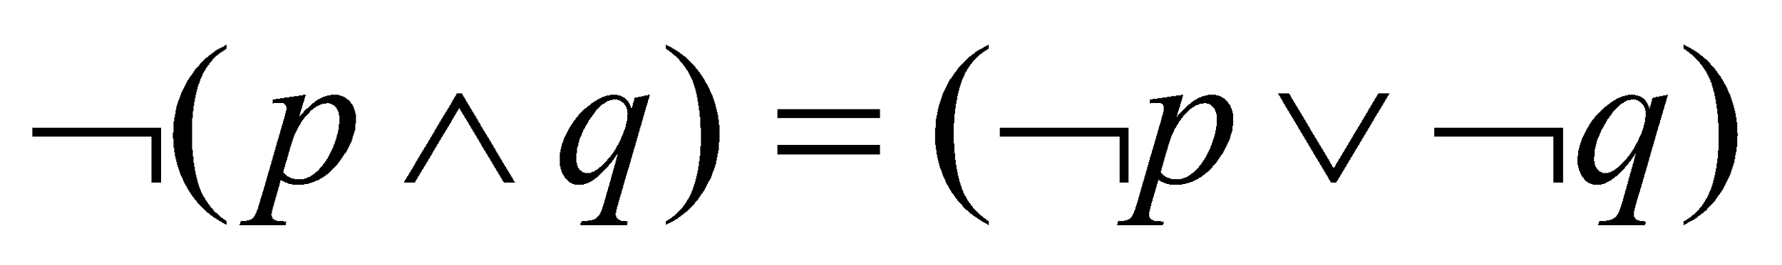
Convert to CNF
Drive in negations using De Morgan’s Law

Slide 37
Convert to CNF
AND distributes over OR: (OR of ANDs)
  P ∧ (Q ∨ R) ≡ (P ∧ Q) ∨ (P ∧ R)
When you apply AND to a whole OR expression, it “distributes” over each term in the OR:
  P = “It rains”
  Q = “I carry an umbrella”
  R = “I wear a raincoat”
    It rains AND (I carry an umbrella OR I wear a raincoat)
  This is equivalent to:
    (It rains AND I carry an umbrella) OR (It rains AND I wear a raincoat)
OR distributes over AND: (AND of ORs)
  P ∨ (Q ∧ R) ≡ (P ∨ Q) ∧ (P ∨ R)

Slide 38
Convert to CNF Example
Example: (A ∨ B) ⇔ (C ⇒ D)
Eliminate ⇔,
  ((A ∨ B) ⇒ (C ⇒ D)) ∧ ((C ⇒ D) ⇒ (A ∨ B)
Eliminate ⇒
  ¬ (A ∨ B) ∨ (¬ C ∨ D) ∧ ¬ (¬ C ∨ D) ∨ (A ∨ B) )
Drive in negations
(¬ A ∧ ¬ B) ∨ (¬ C ∨ D)) ∧ ((C ∧ ¬ D) ∨ (A ∨ B))
Distribute
(¬ A ∨ (¬ C ∨ D) ∧ (¬ B ∨ ( ¬ C ∨ D) ∧ (C ∨ (A ∨ B) ∧ (¬ D ∨( A ∨ B)

Slide 39
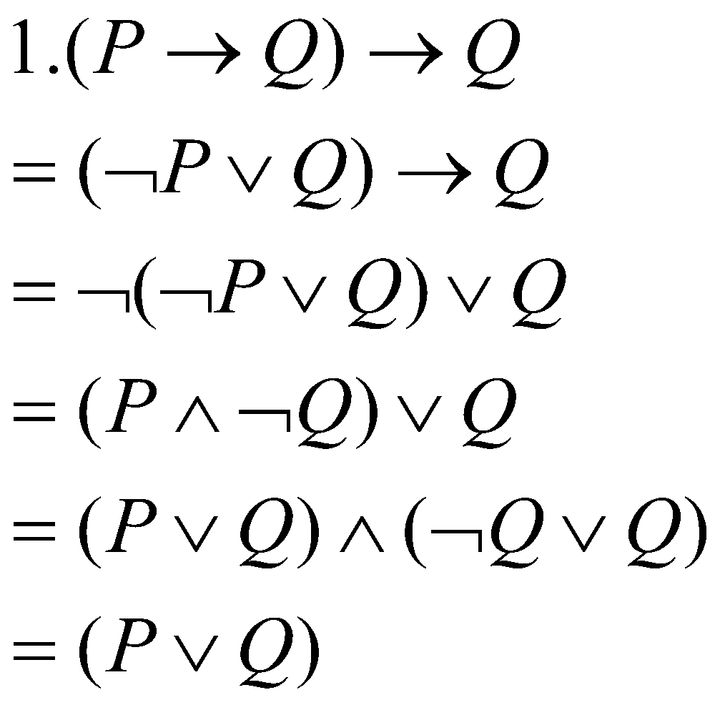
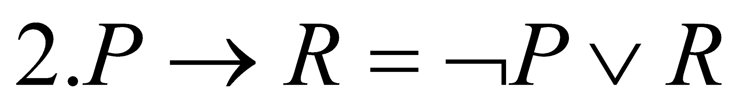
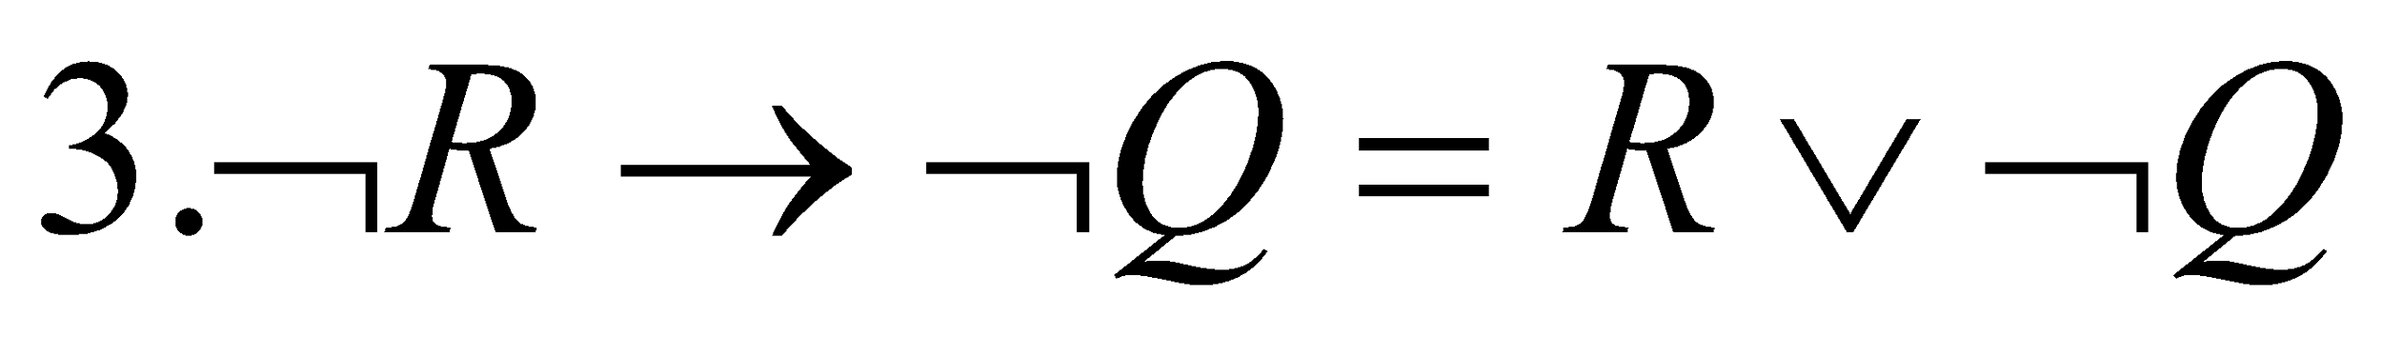
Convert to CNF Example
1. (P→Q) →Q
2. P→R
3. ¬R → ¬Q
Convert to CNF:

Slide 40
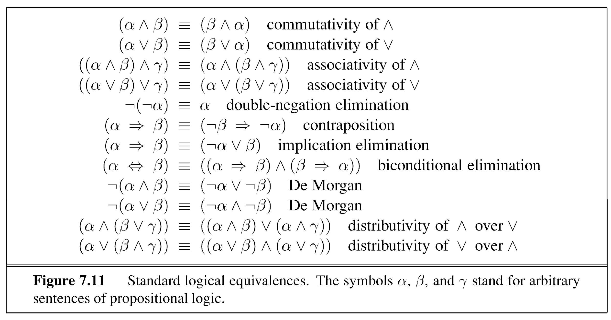
Logical Equivalences

Slide 41
Resolution based Proof
Show that the hypotheses:
¬s ∧ c
w → s
¬w → t
t → h
lead to the conclusion: h

Slide 42
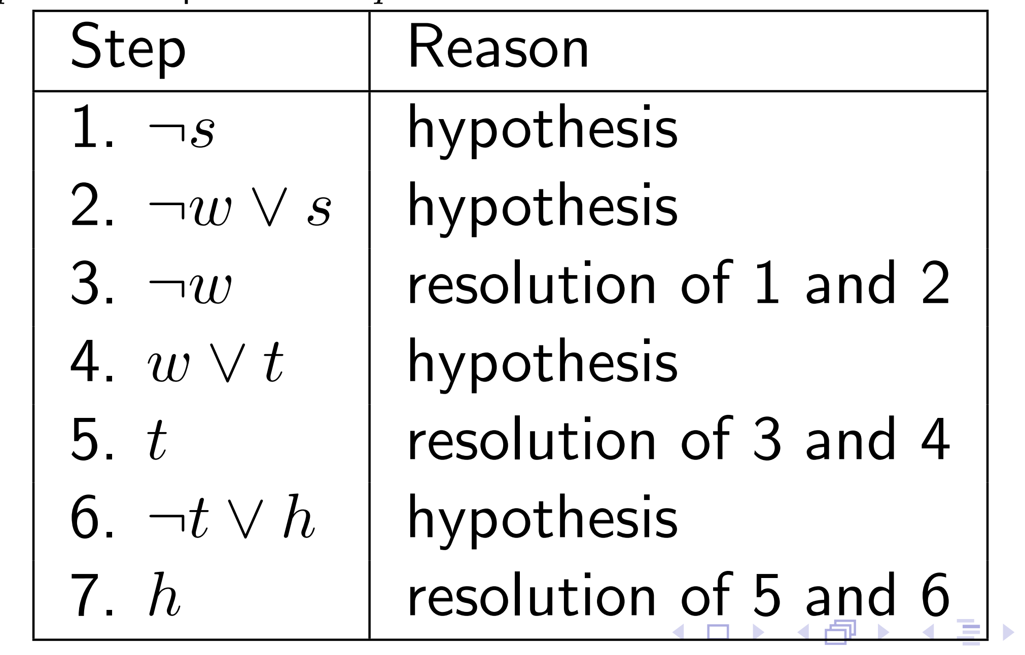
Resolution based Proof

Slide 43
Resolution by Refutation
Proof strategy called Resolution by Refutation. Instead of proving the conclusion directly, we assume the negation of the conclusion and try to show that this assumption leads to a contradiction..
  Write all sentences in CNF.
  Negate the desired conclusion.
  Apply the resolution rule until you derive a contradiction or cannot apply the rule anymore.
If we derive a contradiction, then the original conclusion follows logically from the given clauses.
If no further resolutions are possible, then the conclusion cannot be proved from the given clauses.

Slide 44
Resolution by Refutation Example
Step | Formula | Derivation
1 | P ∨ Q | Given
2 | ¬P ∨ R | Given
3 | ¬Q ∨ R | Given
Prove R
1 | P ∨ Q
2 | P→R
3 | Q →R

Slide 45
Resolution by Refutation Example
Step | Formula | Derivation
1 | P ∨ Q | Given
2 | ¬P ∨ R | Given
3 | ¬Q ∨ R | Given
4 | ¬R | Negated Conclusion
Prove R
1 | P ∨ Q
2 | P→R
3 | Q →R

Slide 46
Resolution by Refutation Example
Step | Formula | Derivation
1 | P ∨ Q | Given
2 | ¬P ∨ R | Given
3 | ¬Q ∨ R | Given
4 | ¬R | Negated Conclusion
5 | Q ∨ R | 1,2 Resolution Rule
Prove R
1 | P ∨ Q
2 | P→R
3 | Q →R

Slide 47
Resolution by Refutation Example
Step | Formula | Derivation
1 | P ∨ Q | Given
2 | ¬P ∨ R | Given
3 | ¬Q ∨ R | Given
4 | ¬R | Negated Conclusion
5 | Q ∨ R | 1,2
6 | ¬P | 2,4
Prove R
1 | P ∨ Q
2 | P→R
3 | Q →R

Slide 48
Resolution by Refutation Example
Step | Formula | Derivation
1 | P ∨ Q | Given
2 | ¬P ∨ R | Given
3 | ¬Q ∨ R | Given
4 | ¬R | Negated Conclusion
5 | Q ∨ R | 1,2
6 | ¬P | 2,4
7 | ¬Q | 3,4
Prove R
1 | P ∨ Q
2 | P→R
3 | Q →R

Slide 49
Resolution by Refutation Example
Step | Formula | Derivation
1 | P ∨ Q | Given
2 | ¬P ∨ R | Given
3 | ¬Q ∨ R | Given
4 | ¬R | Negated Conclusion
5 | Q ∨ R | 1,2
6 | ¬P | 2,4
7 | ¬Q | 3,4
8 | R | 5,7 Contradiction!
Prove R
1 | P ∨ Q
2 | P→R
3 | Q →R

Slide 50
Resolution by Refutation Example
Note that you could have come up with multiple ways of proving R
Step | Formula
1 | P ∨ Q | Given
2 | ¬P ∨ R | Given
3 | ¬Q ∨ R | Given
4 | ¬R
5 | ¬Q | 3,4
6 | P | 1,5
7 | R | 2,6
Step | Formula
1 | P ∨ Q | Given
2 | ¬P ∨ R | Given
3 | ¬Q ∨ R | Given
4 | ¬R
5 | Q ∨ R | 1,2
6 | ¬P | 2,4
7 | ¬Q | 3,4
8 | R | 5,7

